Slide 1
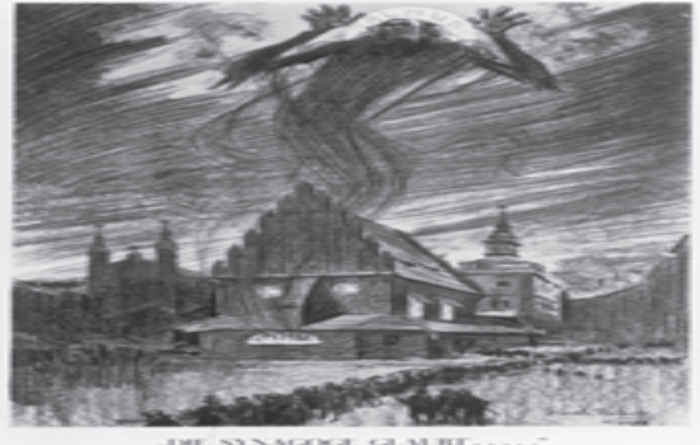
Antisemitic drawing, 1926

Slide 2
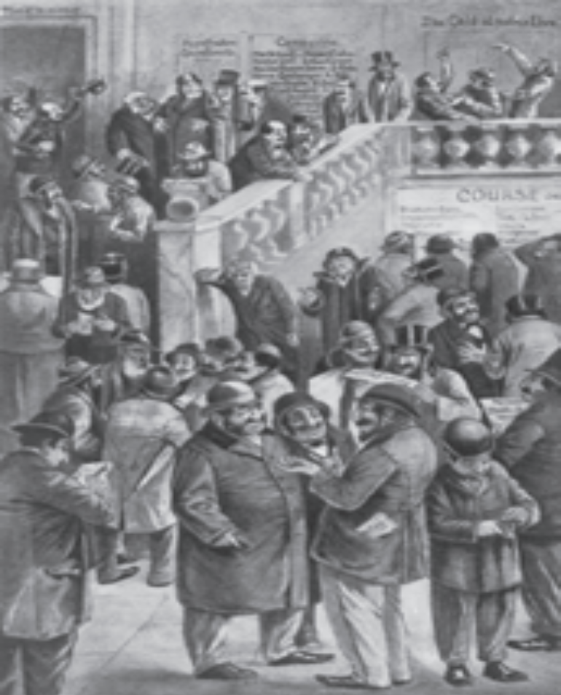
After the German Reich was founded in 1871, Jews
were increasingly stereotypically held responsible for the
negative effects of capitalism, greed and exploitation

Slide 3
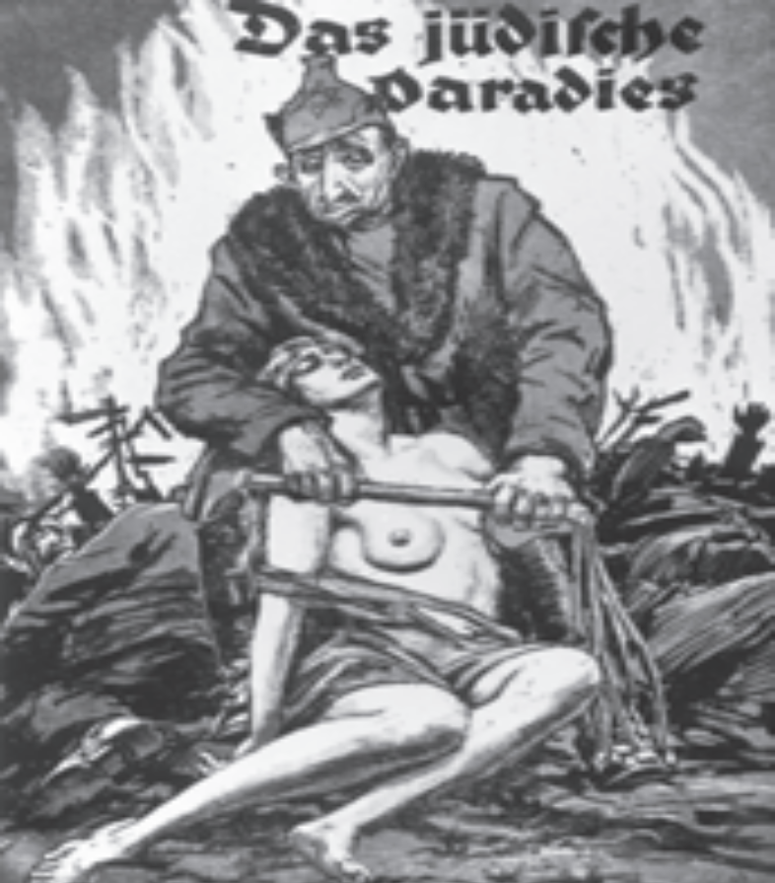
1922:
Bildarchiv Preußischer Kulturbesitz, Berlin
“The Jewish paradise!“

Slide 4
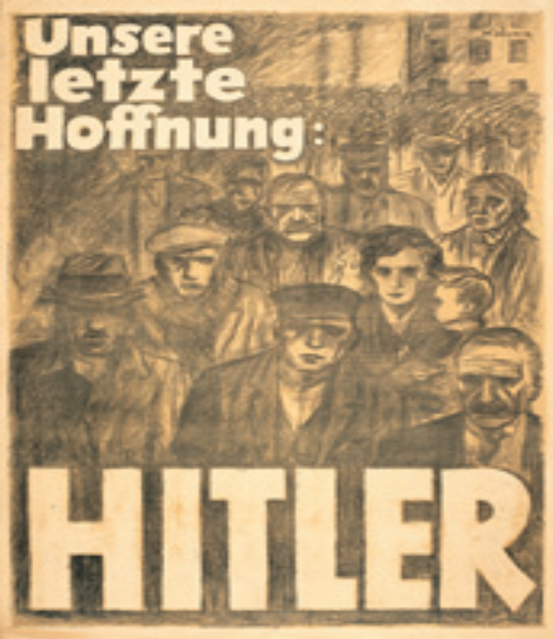
1224 election poster, April 1932
Bayerisches Hauptstaatsarchiv, München
“Our last hope. Hitler.”

Slide 5
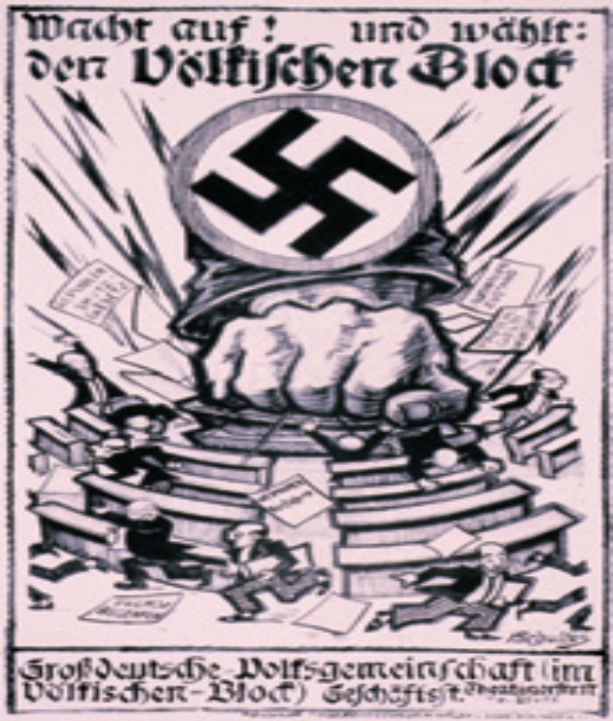
231 Poster of the “Völkischer Block” for the Reichstag elections of 1924
Stadtarchiv München
“Wake up! And vote the Völkischer Block.”
After the failed Hitler Putsch of 1923, the NSDAP
was banned until 1925. Its followers temporarily joined
together with the “Völkischer Block”.

Slide 6
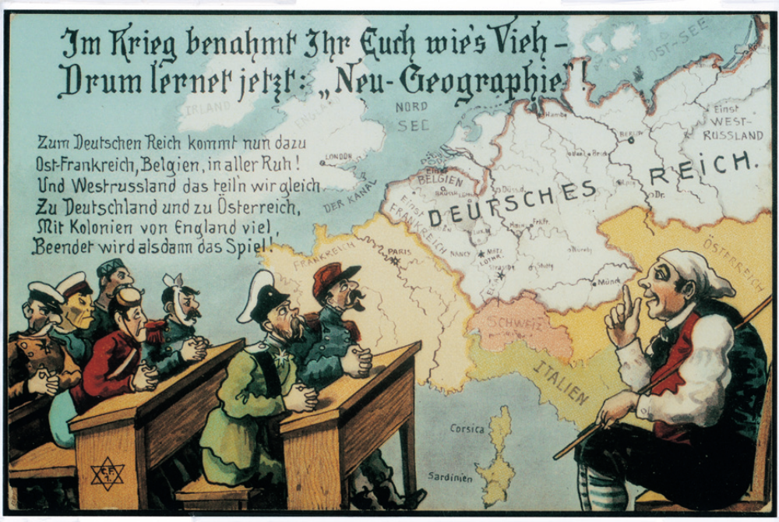

Slide 7
A poem to the Führer
My Führer (The child speaks)
I know you well and love you dearly
Like father and mother.
I want to always be obedient to you
Like I am to father and mother.
And when I grow up, I will help you,
Like I will father and mother,
You should feel joy because of me,
Like father and mother!
Mio Fuhrer
Tu sei buono e ti amo teneramente
come mamma e papà
Ti obbedirò sempre
come a mamma e papà
E da grande, ti sosterrò
come con mamma e papà
Ti darò solo soddisfazioni
come a mamma e papà

Slide 8
1123 Postcard with war propaganda,
Germany, 1915
Sammlung Karl Stehle, München
“In war you behaved like cattle – so you learn
the ‘new geography’! East France, Belgium join
the German Reich peacefully. And West-Russia
we‘ll divide between Germany and Austria.
Lots of colonies from England. And then the
game is over!”

Slide 9


Slide 10
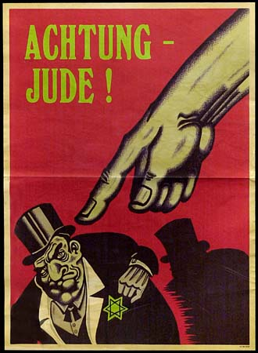

Slide 11
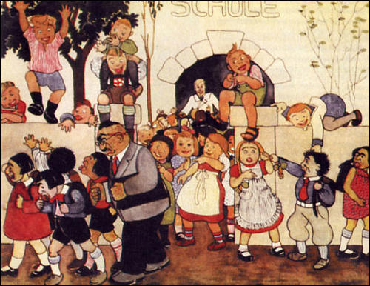
ANTISEMITIC PROPAGANDA

Slide 12
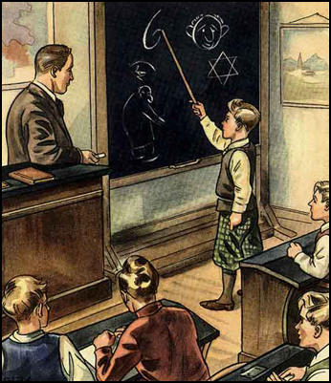
AT SCHOOL

Slide 13
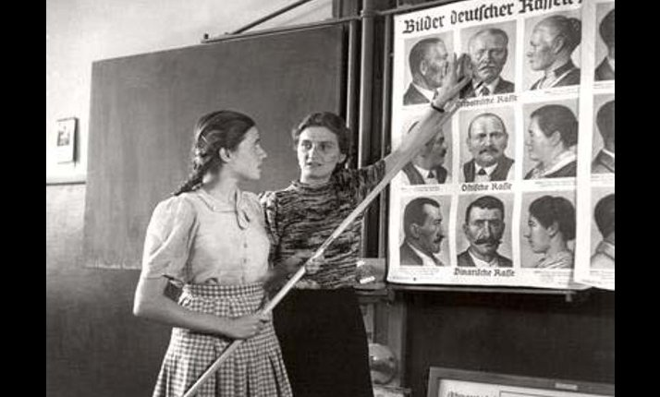

Slide 14
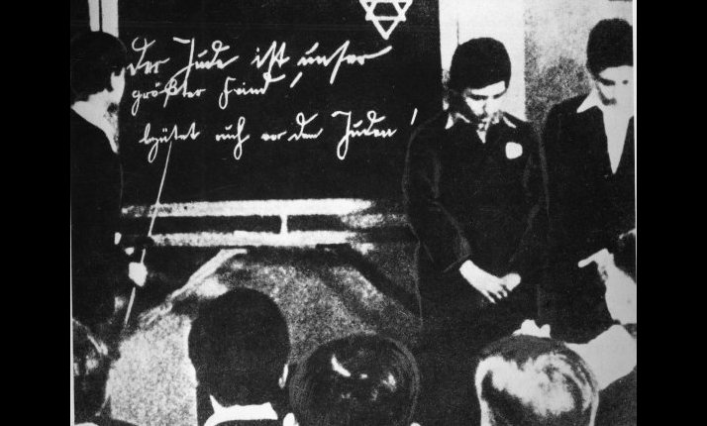

Slide 15
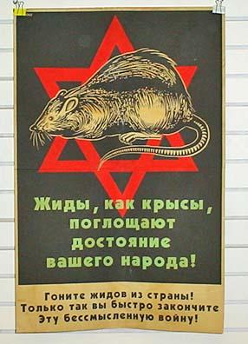
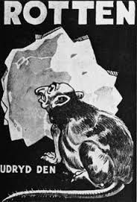
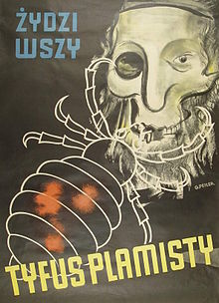
ANTISEMITIC POSTERS

Slide 16
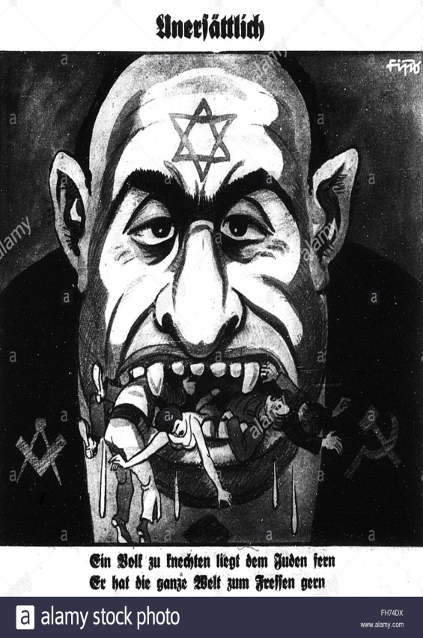

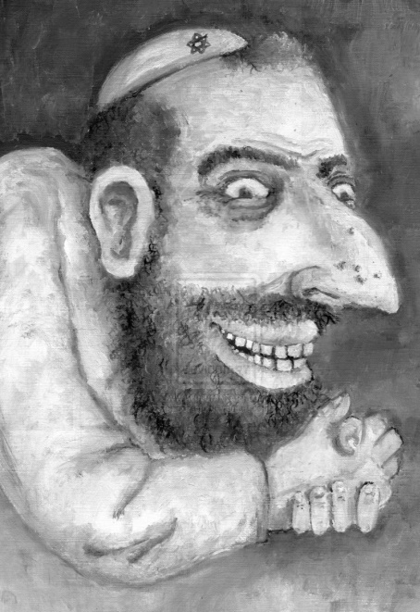
ANTISEMITIC POSTERS

Slide 17
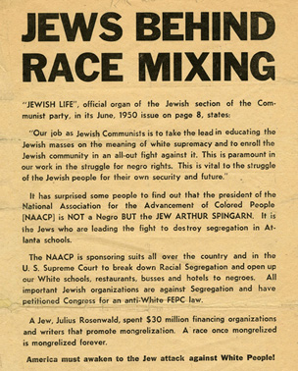

Slide 18
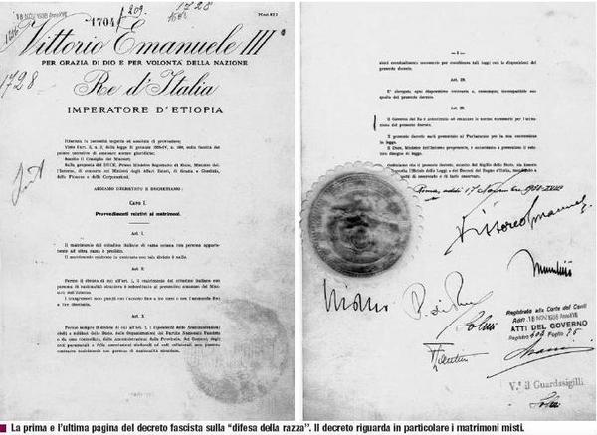

Slide 19
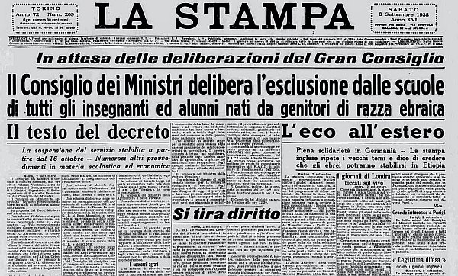

Slide 20
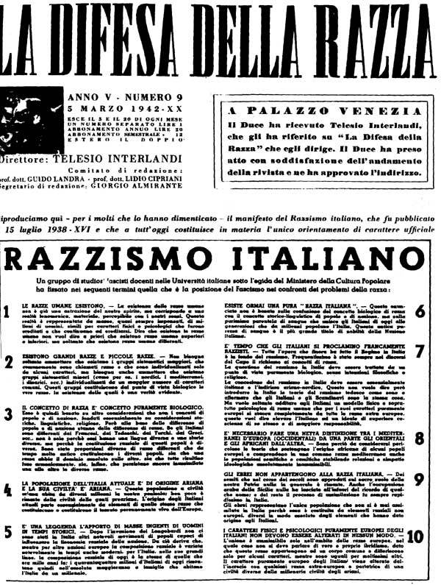

Slide 21
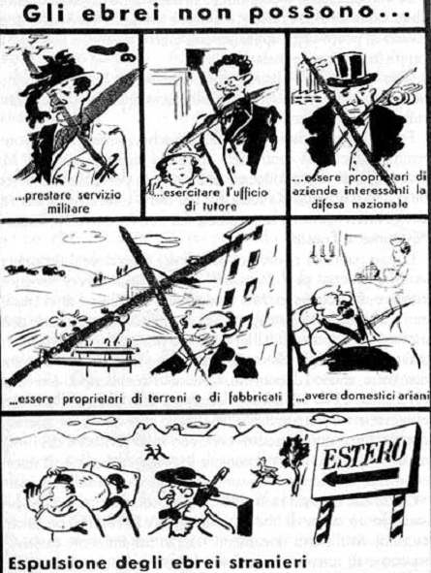

Slide 22
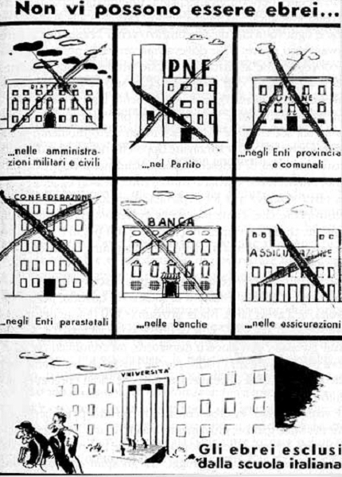

Slide 23
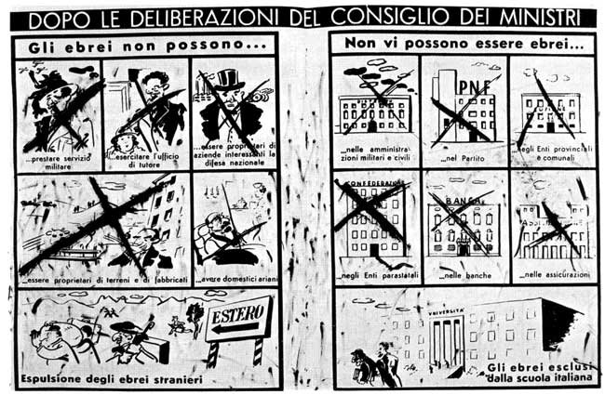

Slide 24
