Slide 1
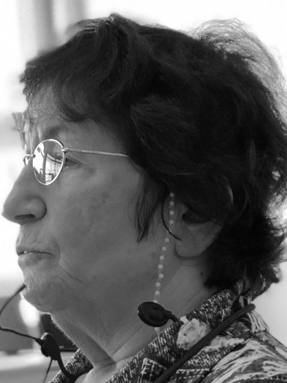
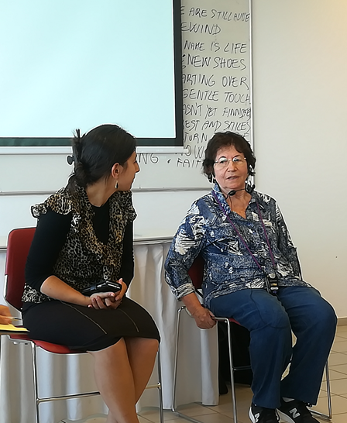
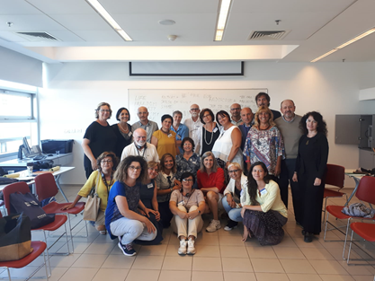
Jeudith Kleinmann
ALL MY MOTHERS
LE MIE MADRI

Slide 2
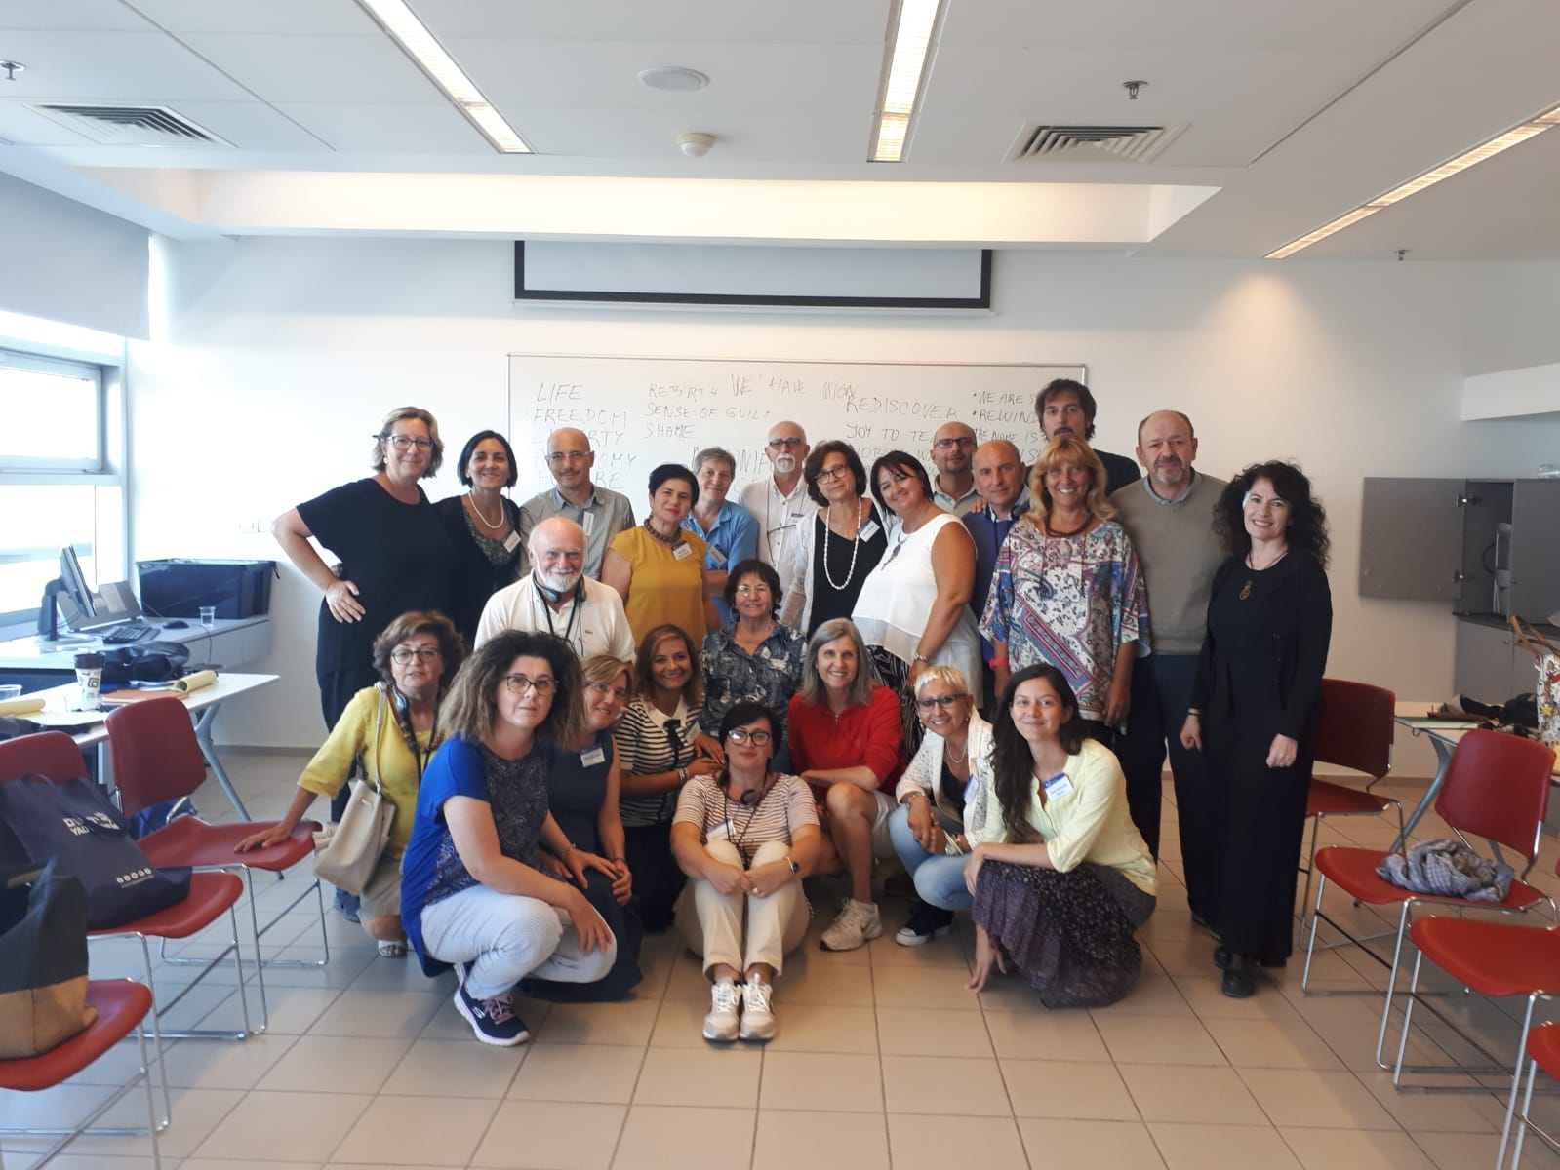
YAD VASHEM

Slide 3
History as continuum: Presenting the victims in three-fold periodization before – during – after persecution
LIFE BEFORE THE HOLOCAUST
Yehudith Kleinman, was a little girl who had to make three fateful choices that in a normal world, no child should ever have to make.
She lived in Venice, she was born in 1938 and she moved to Milan three years later, with her mother Anna, her grandma Leah, without her father because who had disappeared.
DURING
One day in January 1944 her happy childhood came to end, her mum was called from the public phone which was at the entrance of their building, she went downstairs. She couldn’t hear what she said because she whispered into the phone, but when mum put down the phone, she saw that she was pale so asked why , but mum didn’t answer. With grandma, they packed two suitcases in a hurry. Yehudith asked to where were they going, she felt that something terrible was going to happen.
AFTER
When Second World War finished the “Bricha”, a Jewish brigade was determined to find all Jewish and take them to Eretz Israel.
Yehudith first went to Salvino and then left to her new life
When she was deported to the convent she had to change her name from Yehudith to Ditha.

Slide 4
CONTEXTUALIZE
CONTESTUALIZZARE
DOVE
WHERE
TRAUMA
CHOICE
SCELTA
With whom do you want to go?
Who are you?
Where do you want to go?
A sense of loneliness and abandonment,
In Italy
MILAN
SALVINO
ISRAEL
SILENCE .. she couldn’t say a word when she was in difficulty.

Slide 5
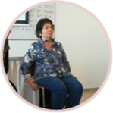
CONTEXTUALIZE
CONTESTUALIZZARE
Choices:
1) With whom do you want to go?
She looked to mum’s eyes which said that “don’t
chose me”.
2) Who are you?
She couldn’t tell anyone that she was Jewish so
she said she was Ditha and a Christian girl.
3) Where do you want to go?
She decided to go to Eretz Israel because she thought her mum and grandma could be there; in fact all Jewish people were deported there after Second World War to build a new life

Slide 6
IDENTITY
1 Ditha during the day
2 Yehudith at night
WHO IS WHO? CHI E’ CHI?
In the Christian convent she made friends white two girls, then she made friends also in Salvino with some others.
RELATIONSHIPS – VITA SOCIALE
Back in Israel, she learns Hebrew, becomes a teacher and begins a new life…
VICTORY
VITTORIA
EGO - DOCUMENTS

Slide 7
You can make the difference
Puoi fare la differenza
Writing my reactions
I’m very surprised , she was a very brave child, despite the situation
Reading my reactions
What happens mum? …
Storytelling my reactions
At night I’ll be a Jew, but in the morning I’m a Christian

